Slide 1

5/5/2021
Note: The research reported here was supported by the Institute of Education Sciences, U.S. Department of Education, through Grant R305E150006 to the Regents of the University of California. The opinions expressed are those of the authors alone and do not represent views of the Institute or the U.S. Department of Education, or of the agencies providing data.

Slide 2
Missing Variable Patterns
How many schools are left with no question missing?
No question missing in all surveys: 953
School climate: 1023
Teacher and staff quality: 1029
Student Support: 1239
Student Motivation: 1363

Slide 3
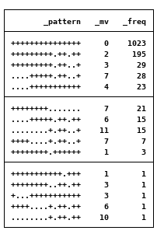
School Climate

Slide 4
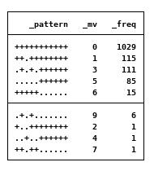
Teacher and Staff Quality

Slide 5
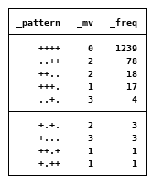
Support for Students

Slide 6

Student Motivation
First 3 vars in the category has no missing values.

Slide 7
What to do with missing values
1. Complete case analysis – drop schools with missing values
Easy to do, don’t lose too many observations
2. Multiple imputations for each category
Problem: Student Support and Student Motivation categories do not have variables with no missing values

Slide 8
PCA Composite Scores
Created composite scores from
1st principal component for secondary and parent surveys
1st and 2nd principal component for staff survey

Slide 9
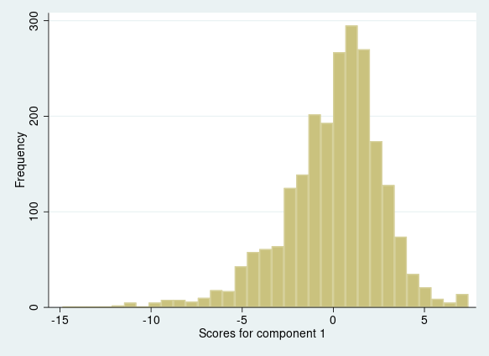
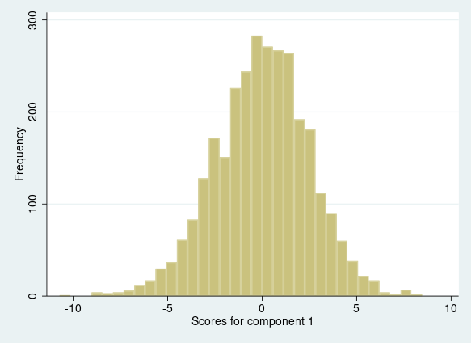
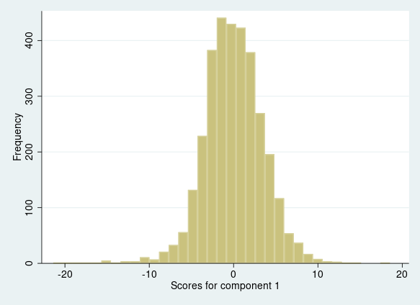
Distribution
Parent
Staff PC1
Secondary
Staff PC2

